Slide 1
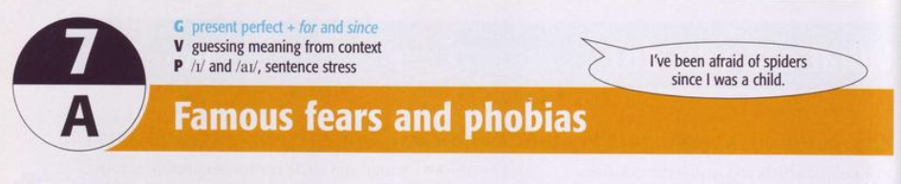
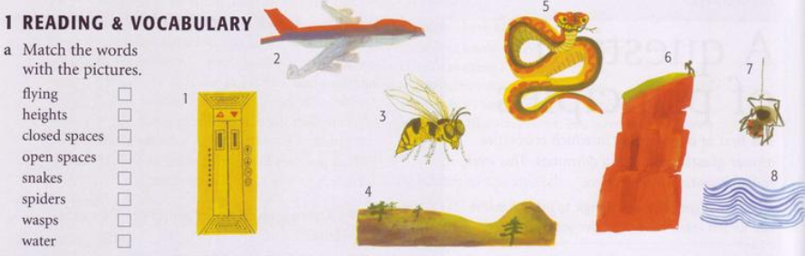
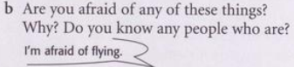

Slide 2
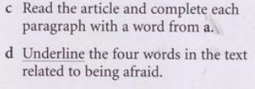
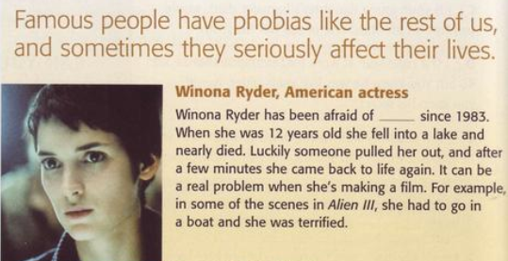
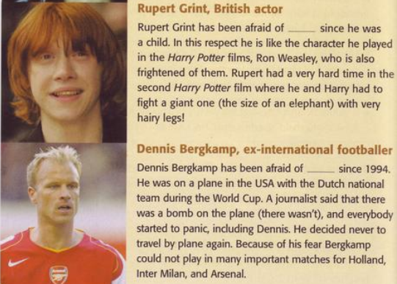
spiders
water
height

Slide 3
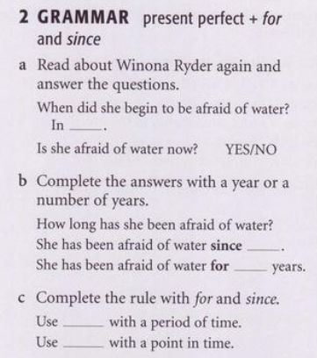
1983
1983
39
SINCE
FOR

Slide 4
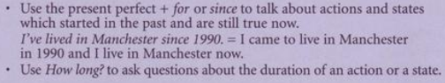
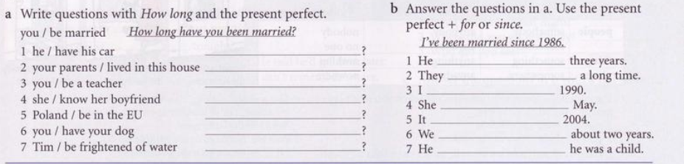

Slide 5
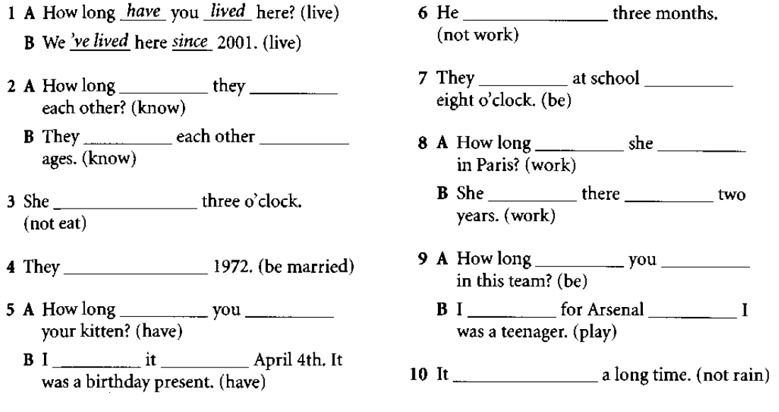

Slide 6
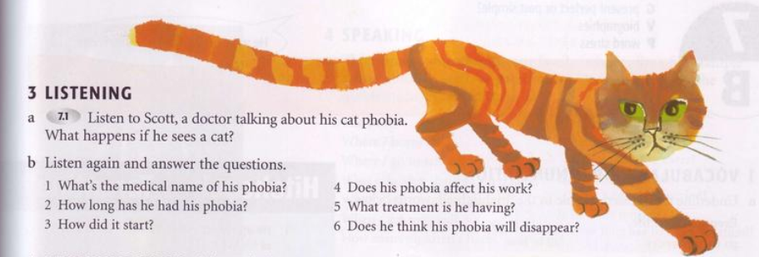

He starts to feel very nervous. His heart beats so quickly. And he tarts to go away from where the cat is
1. Felinophobia or gatophobia
2. Since he was 5 or 6
4.Yes, sometimes ( he can’t be in the same room with a cat)
3. A friend’s cat bit him
5. He is going to a therapist.
6. Yes, he is optimistic.

Slide 7
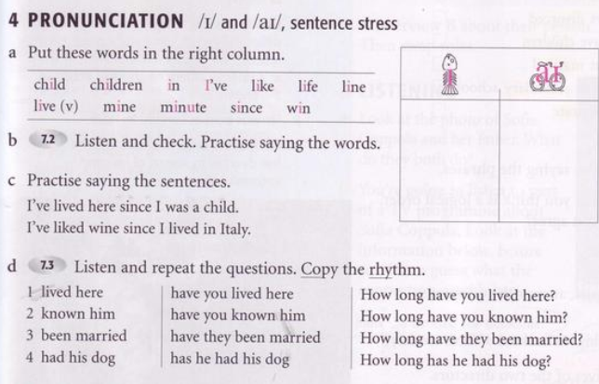


Slide 8
